Slide 1
Machine Learning (ML) RIME-832
Dr. Muhammad Jawad Khan

Slide 2
Regression

Slide 3
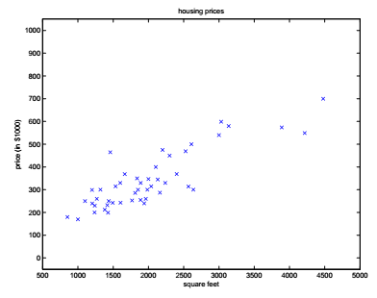
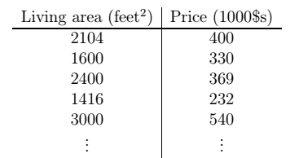
Linear Regression with ONE variable
Suppose we have a dataset with living area and prices of houses in US

Slide 4
Linear Regression with ONE variable
Supervised/unsupervised?
Classification/regression/clustering?
Notations:
m = number of training examples
x’s = input variable/feature
y’s = output/target variable
(x,y)=one training example
(x^{(i),}y^{(i)})= i^{th} training example
{(x^{(i),}y^{(i)});i=1,…….,m} = training set

Slide 5
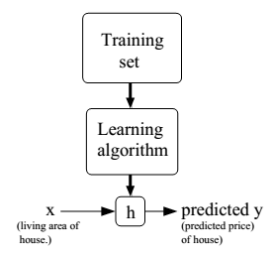
Supervised Learning Formal Definition
Learning algorithm outputs a function h, also called as hypothesis.
h takes as input (x), the size
of the house and outputs
the estimated value of y
h maps input x to output y
How to represent h?

Slide 6
Linear Regression with ONE variable
Initial choice of h:
h_{θ}(x) = θ₀+ θ₁x
Shorthand notation of h_{θ}(x) is h(x).
What is this function?
This model is known as …..

Slide 7
Linear Regression with ONE variable
We have a training set with m training examples and the following hypothesis
h_{θ}(x) = θ₀+ θ₁x
What are θ’s and what values to choose for them?
What happens when
Θ₀ = 1.5 and θ₁ = 0
Θ₀ = 0 and θ₁ = 0.5
Θ₀ = 1 and θ₁ = 0.5

Slide 8
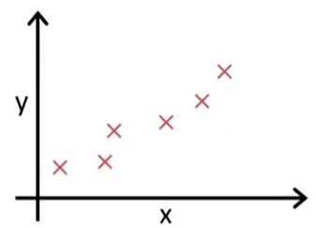
Linear Regression with ONE variable
How to fit best possible straight line to our data?
Solution: choose the values of Θ₀ and θ₁ ,so that h_{θ}(x) is close to y, for our training examples.

Slide 9


Linear Regression with ONE variable
Formally, we can find θ₀ and θ₁ by using the following cost function:
Where are the parameters θ₀ and θ₁ in the equation?
Loss known as squared error function (most common for regression problems)

Slide 10
Linear Regression with ONE variable
Summary
Hypothesis
h_{θ}(x) = θ₀+ θ₁x
Parameters
θ₀,θ₁
Cost Function
Goal

Slide 11
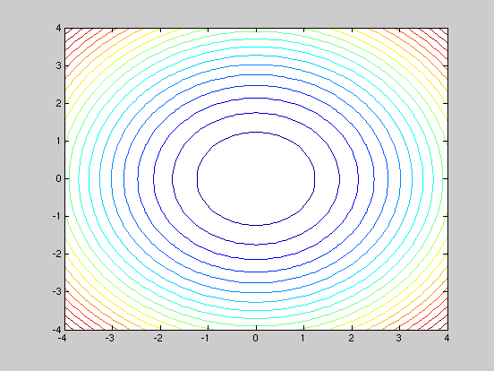
Contour Plot

Slide 12
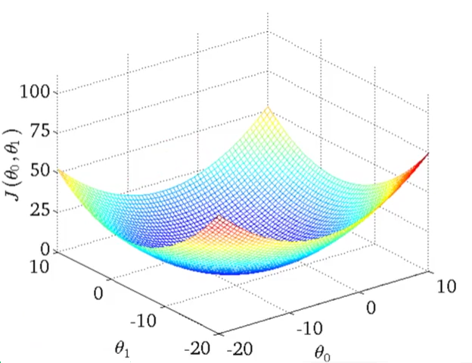
Linear Regression with ONE variable

Slide 13
Linear Regression with ONE variable
How to automatically find the best set of parameters?

Slide 14
Gradient Descent Algorithm
Given
J(θ₀,θ₁)
Goal
A general algorithm to estimate parameters (θ₀,θ₁, θ₂,…………..,θ_{n})

Slide 15
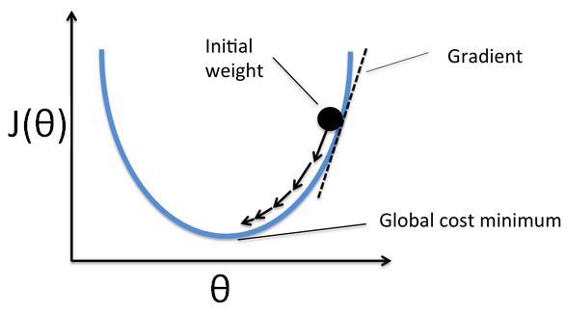
Gradient Descent Algorithm
Intuition

Slide 16
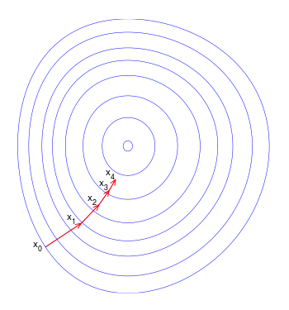
Gradient Descent Algorithm
Intuition

Slide 17
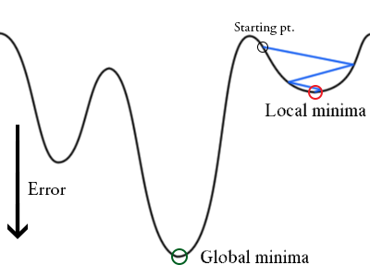
Gradient Descent Algorithm
Problems:
Starting point/initial value of parameter
Local minima/global minima

Slide 18
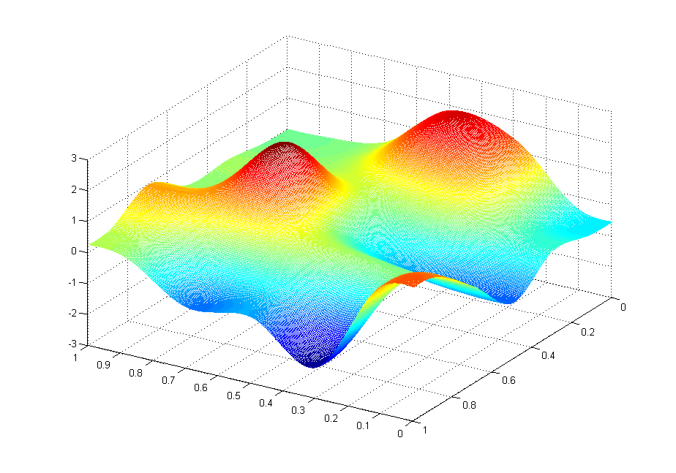
J(θ₀,θ₁)
θ₁
θ₀

Slide 19
J(θ₀,θ₁)
θ₁
θ₀

Slide 20
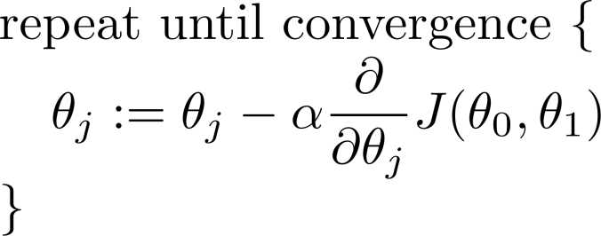
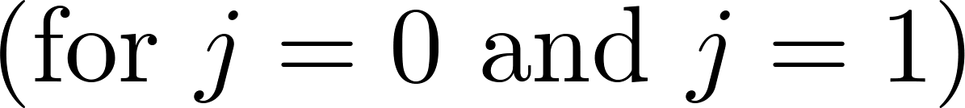
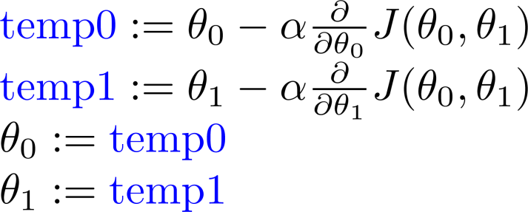
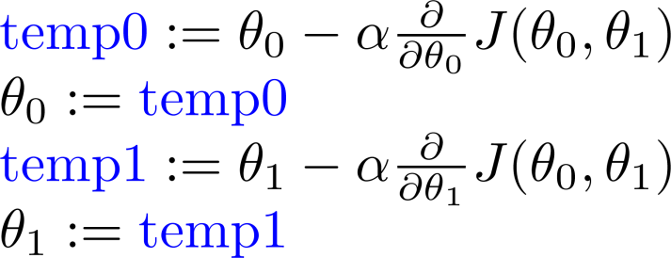
Gradient Descent Algorithm
Correct: Simultaneous update
Incorrect:

Slide 21
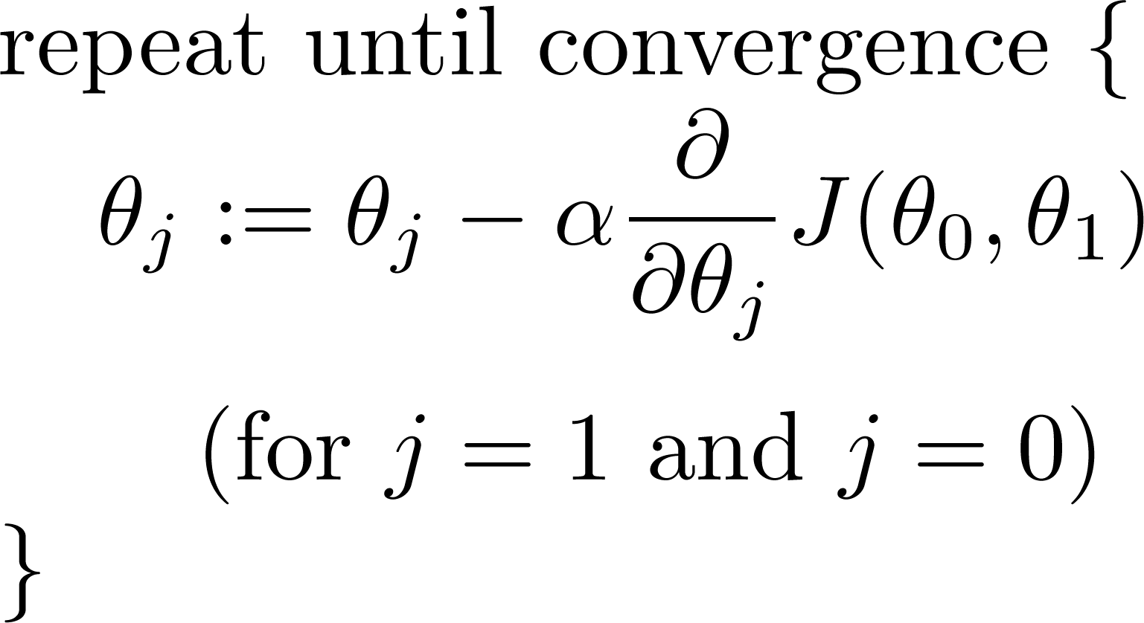
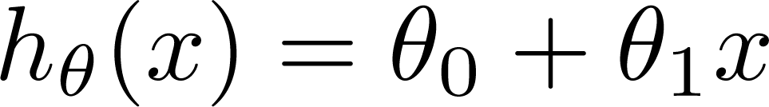
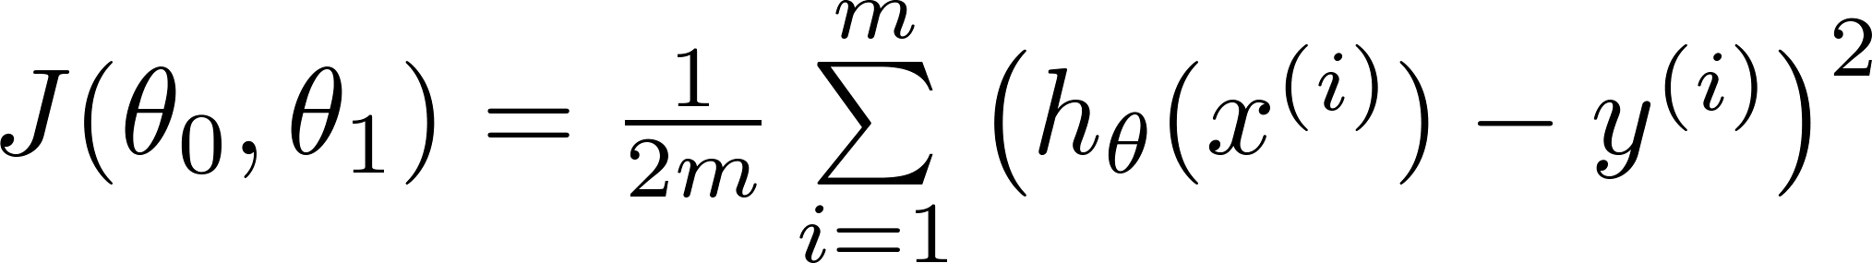
Gradient Descent for Linear Regression
Gradient descent algorithm
Linear Regression Model

Slide 22
Gradient Descent for Linear Regression
The key is the derivative term …..

Slide 23
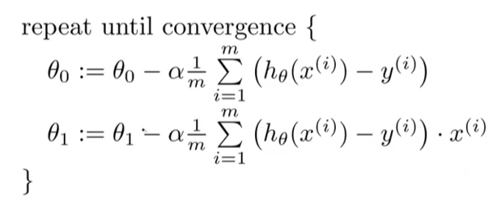
Gradient Descent for Linear Regression

Slide 24
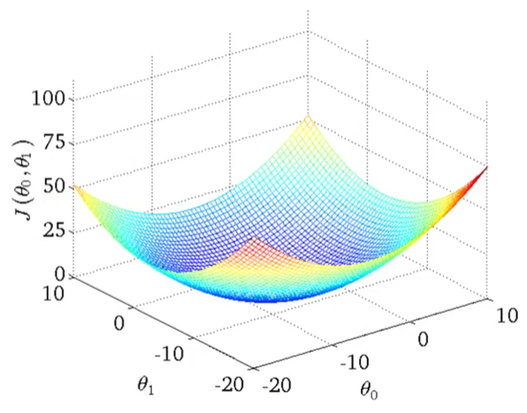
Gradient Descent for Linear Regression
Cost function of linear regression is bowl shaped also known as convex functions

Slide 25

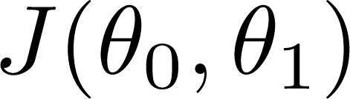


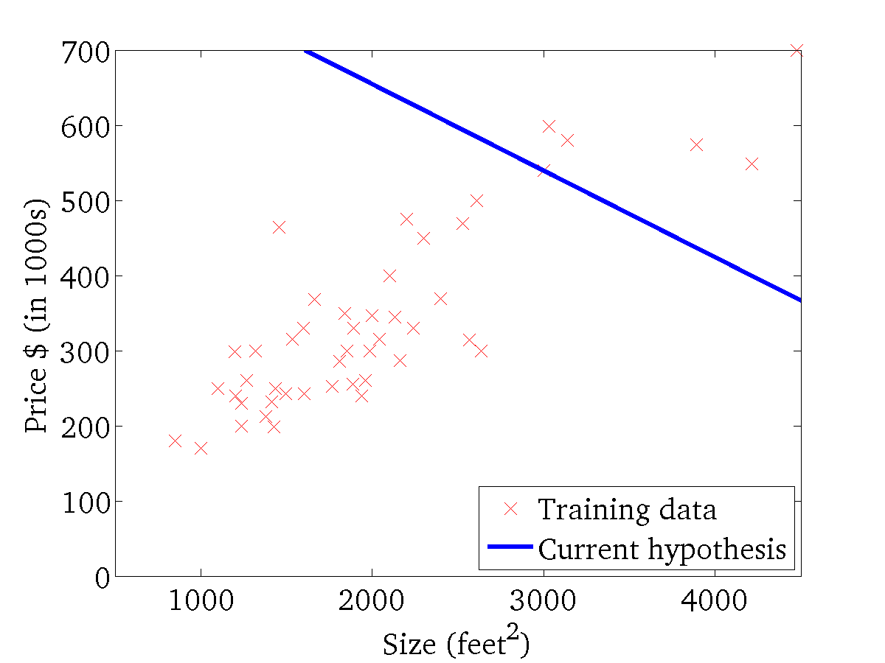
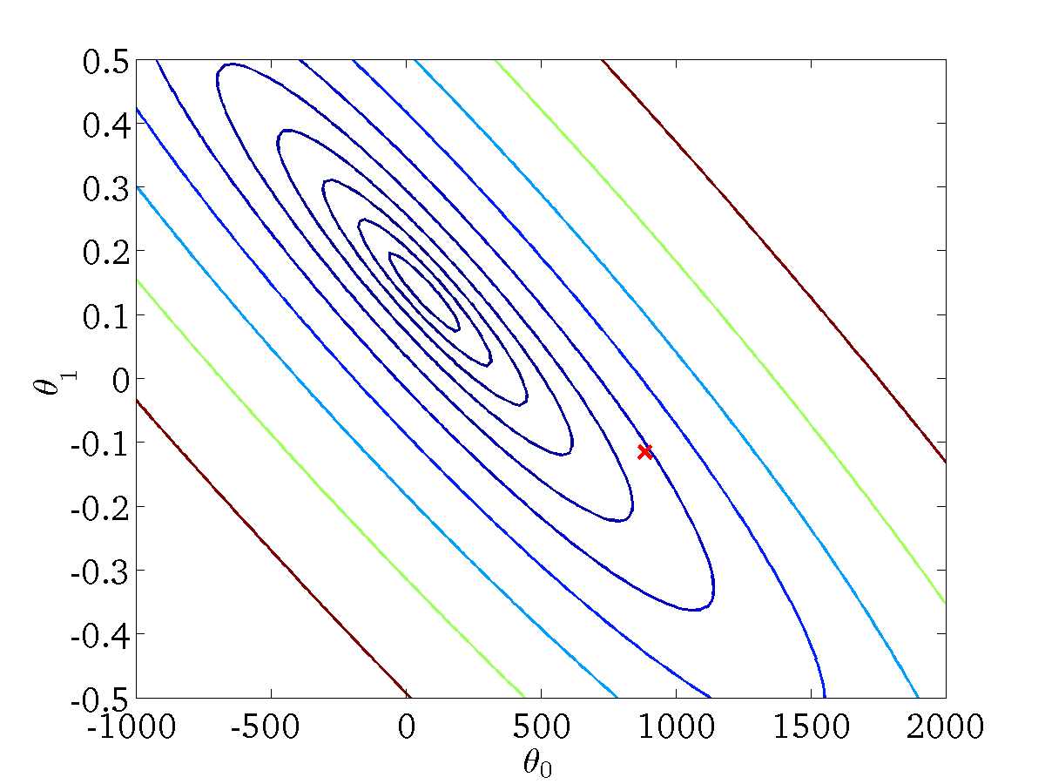
(for fixed , this is a function of x)
(function of the parameters )

Slide 26
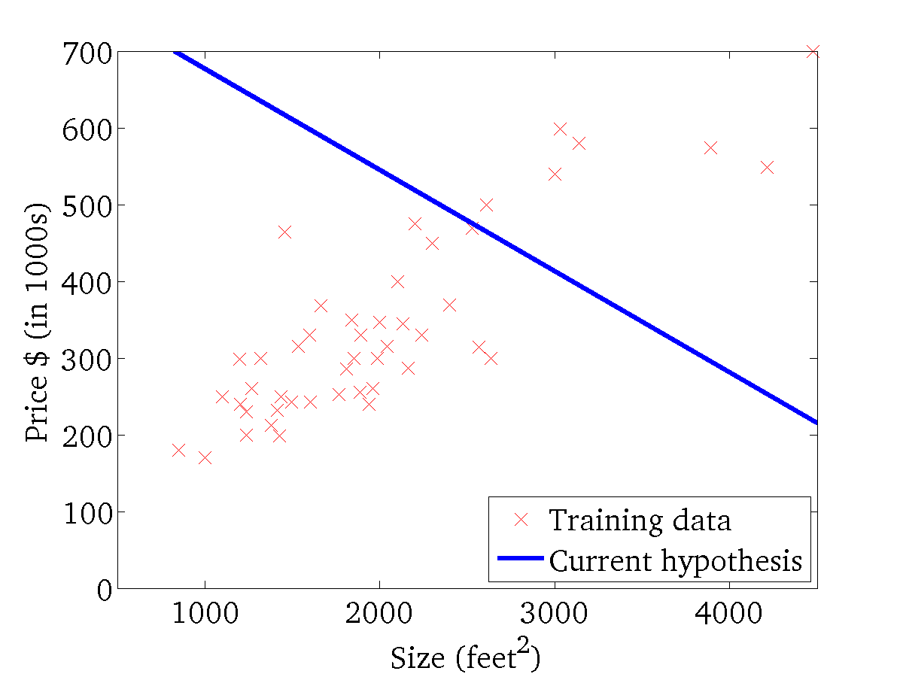

(for fixed , this is a function of x)
(function of the parameters )

Slide 27
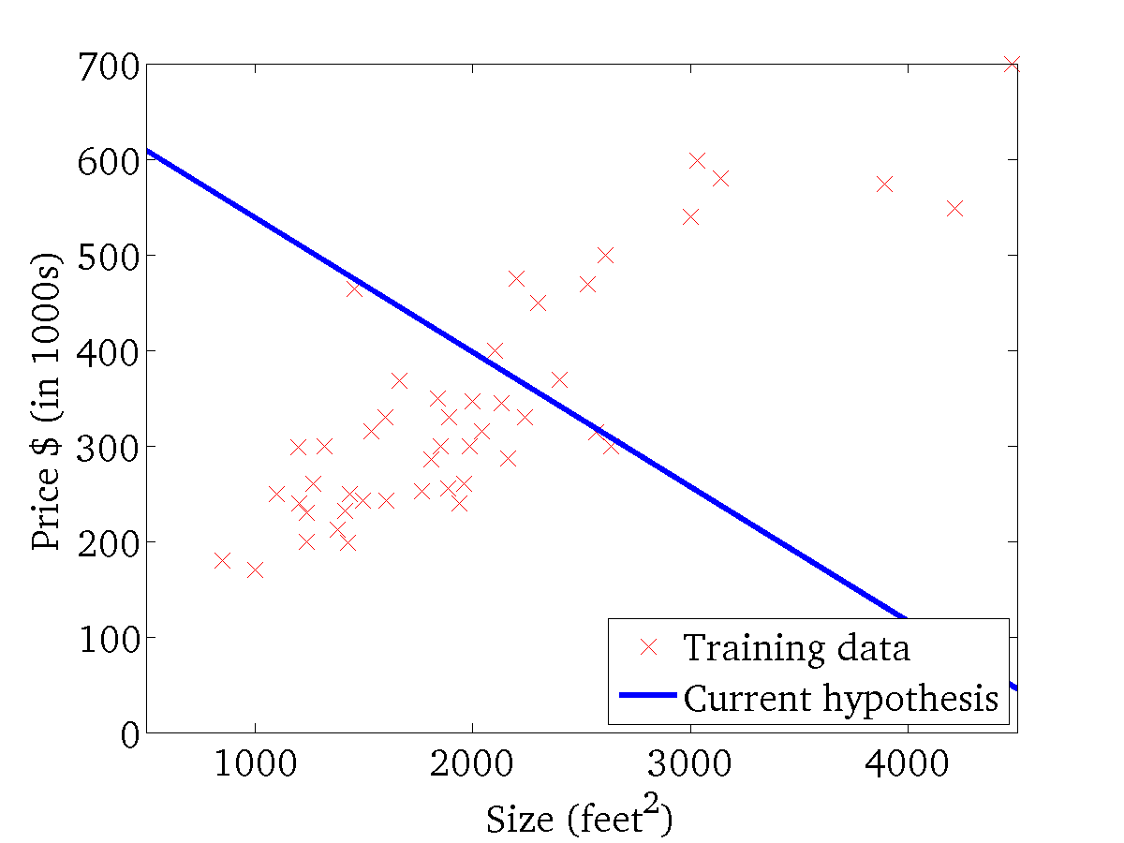
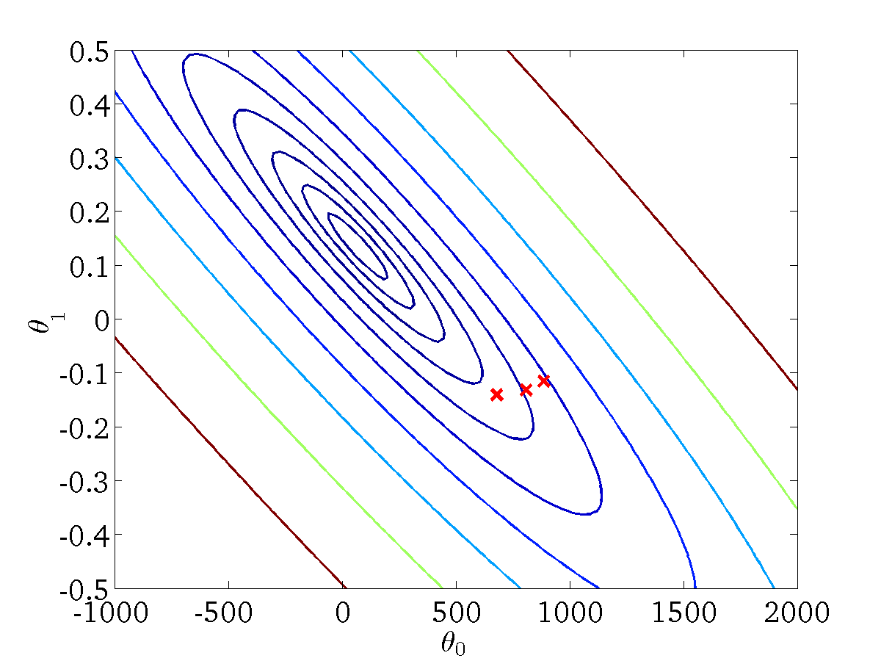
(for fixed , this is a function of x)
(function of the parameters )

Slide 28
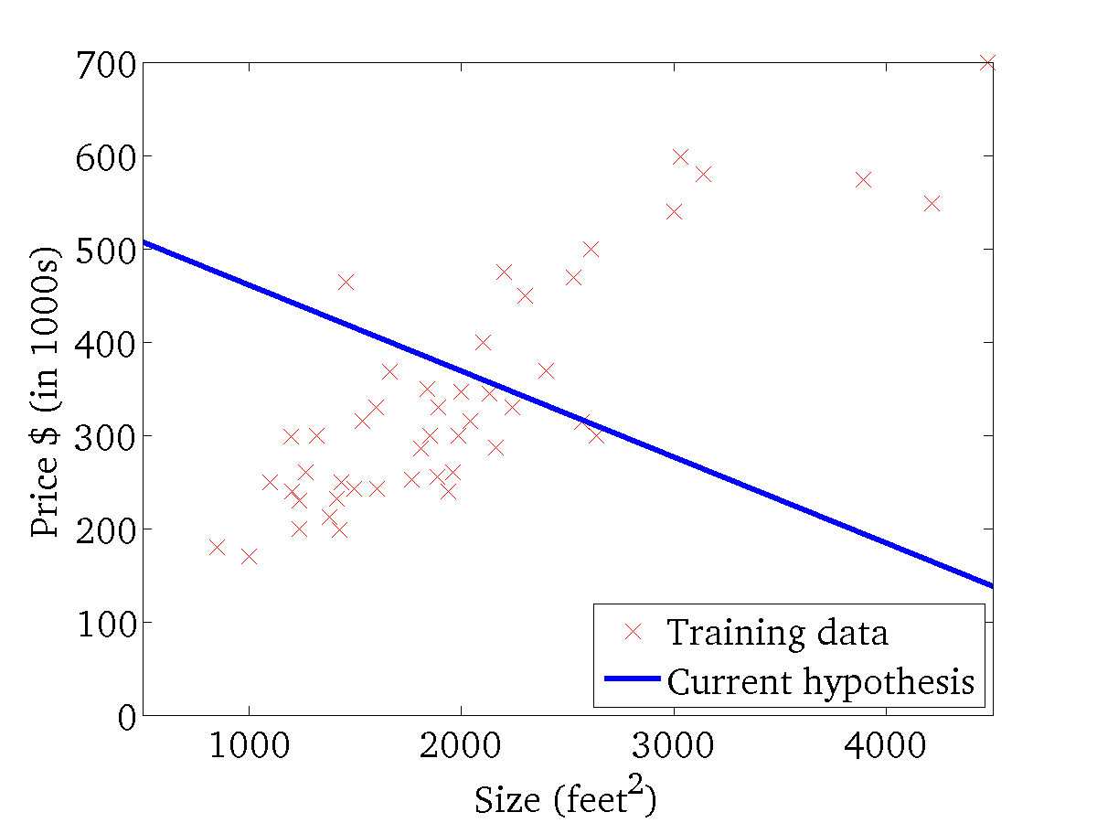

(for fixed , this is a function of x)
(function of the parameters )

Slide 29
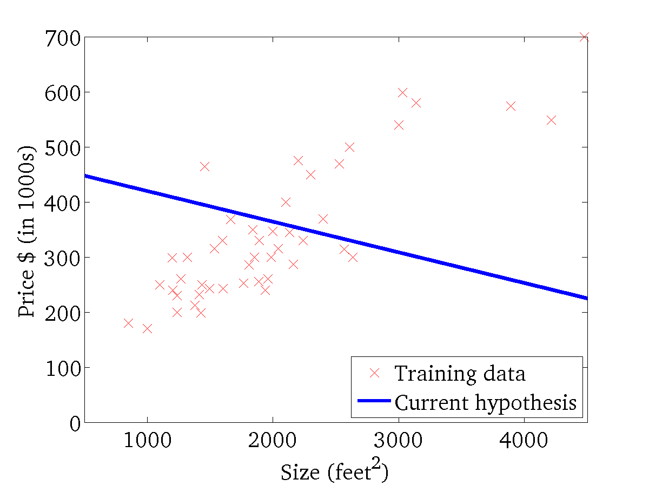
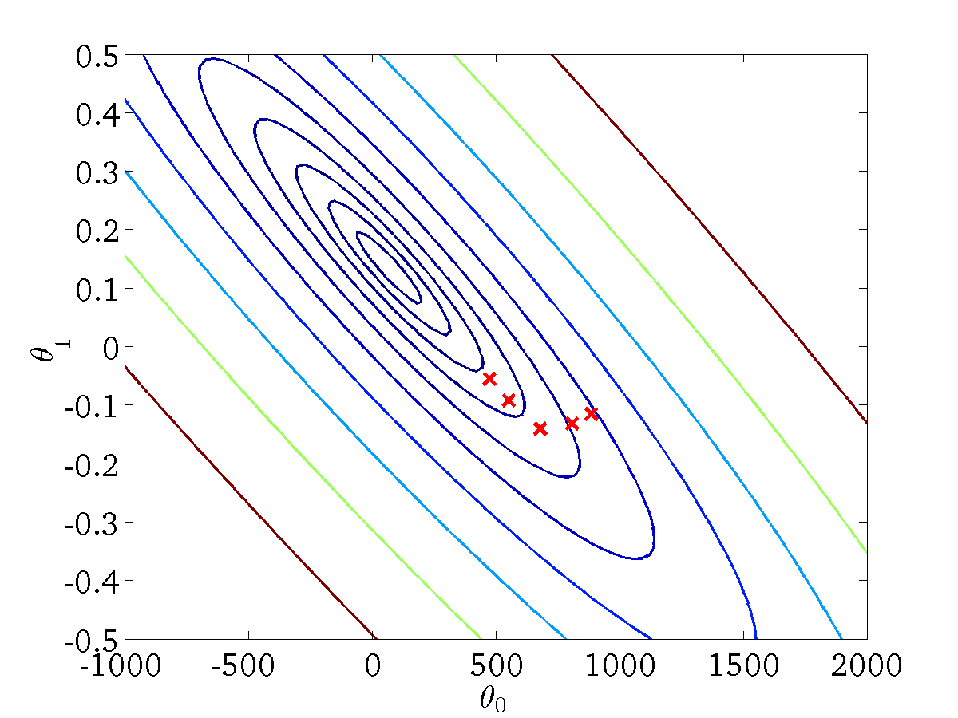
(for fixed , this is a function of x)
(function of the parameters )

Slide 30
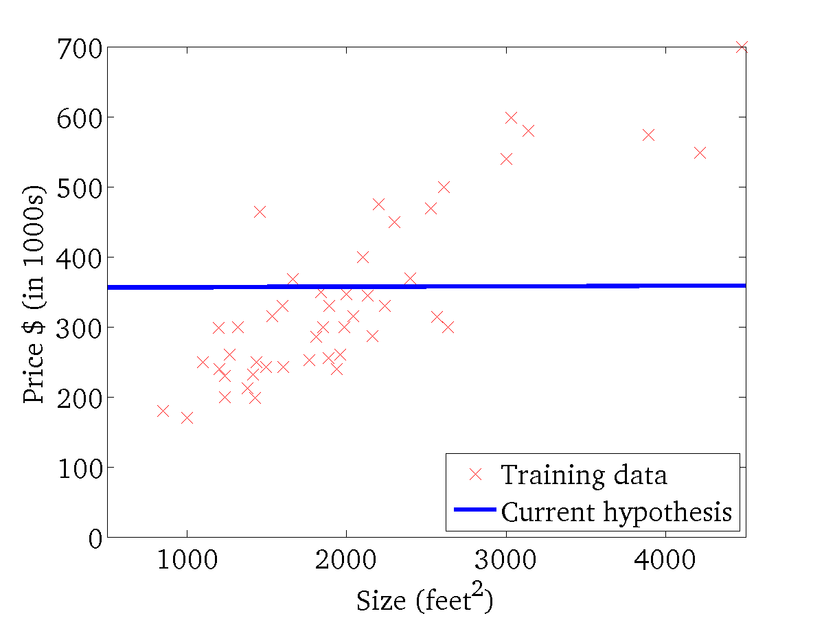

(for fixed , this is a function of x)
(function of the parameters )

Slide 31
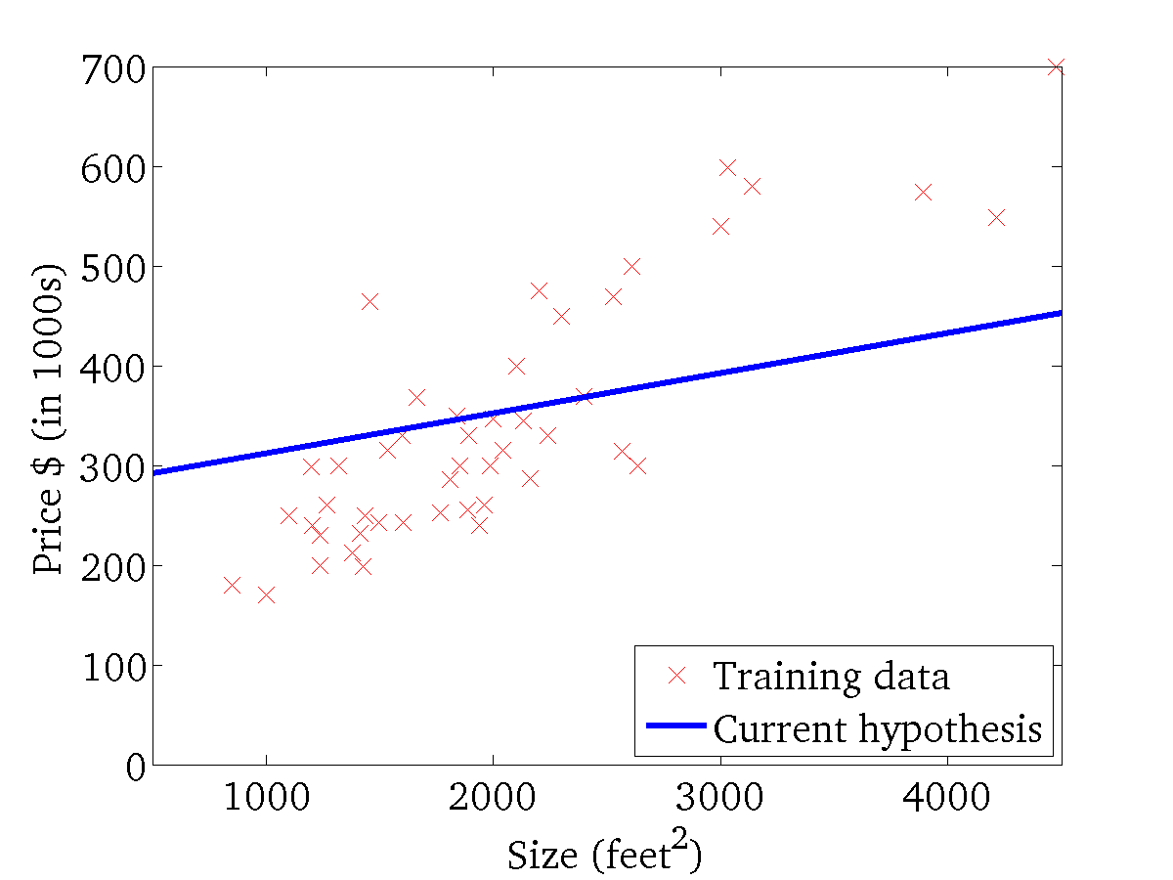

(for fixed , this is a function of x)
(function of the parameters )

Slide 32
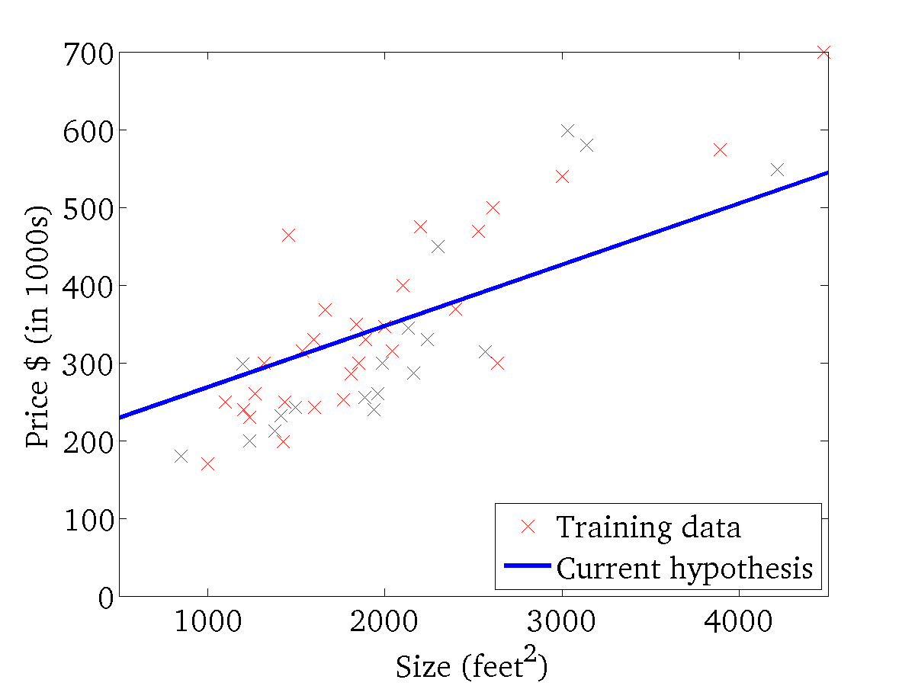
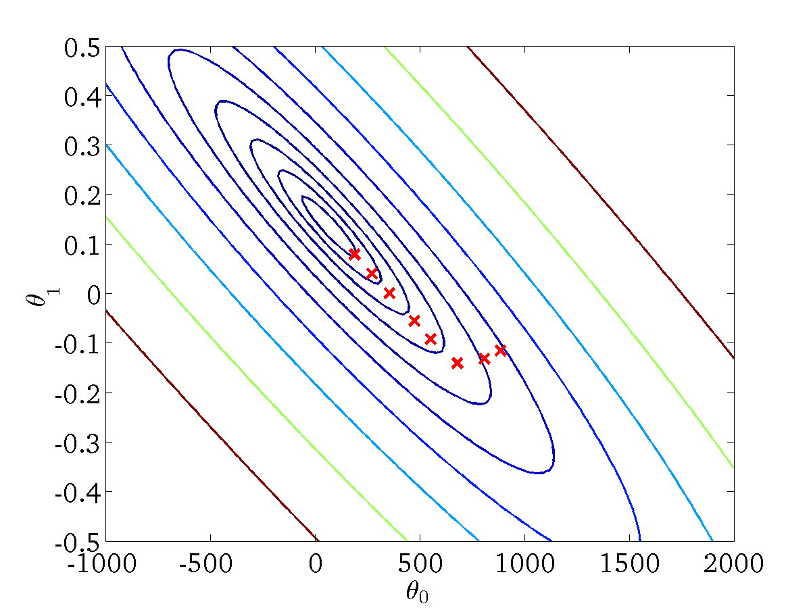
(for fixed , this is a function of x)
(function of the parameters )

Slide 33
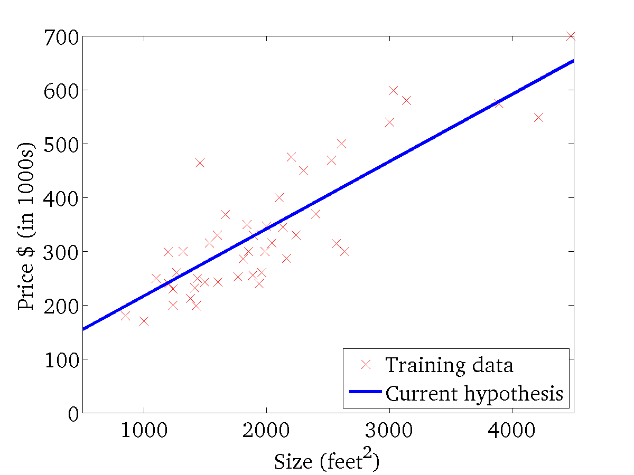

(for fixed , this is a function of x)
(function of the parameters )

Slide 34
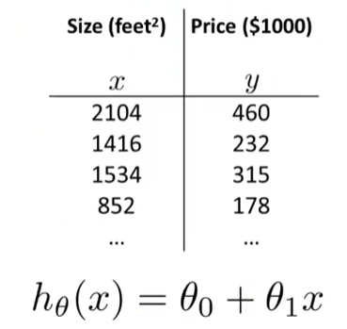
Linear Regression with MULTIPLE Variables
Also known as Multivariate Linear Regression

Slide 35
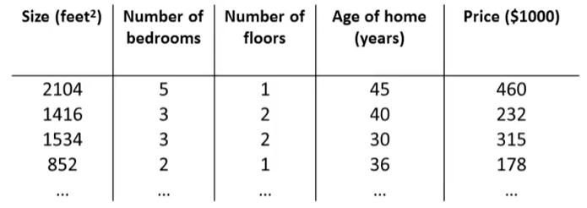
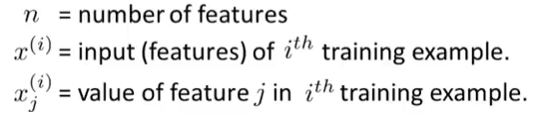
Linear Regression with MULTIPLE Variables
Multiple features (variables)
Notation

Slide 36
Linear Regression with MULTIPLE Variables
Previous Hypothesis
h_{θ}(x) = θ₀+ θ₁x
Now
h_{θ}(x) = θ₀+ θ₁x₁+ θ₂x₂+ θ₃x₃ + θ₄x₄
Example
h_{θ}(x) = 80+ 0.1x₁+ 0.01x₂+ 3x₃ - 2x₄

Slide 37
Linear Regression with MULTIPLE Variables
Generally
h_{θ}(x) = θ₀+ θ₁x₁+ θ₂x₂+ θ₃x₃ +………+ θ_{n}x_{n}
For Convenience, define x₀=1
h_{θ}(x) = θ₀x₀+ θ₁x₁+ θ₂x₂+ θ₃x₃ +………+ θ_{n}x_{n}
= θ^{T}X

Slide 38
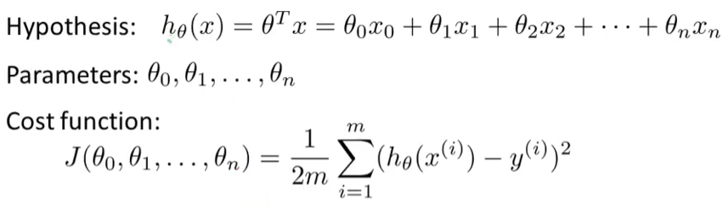
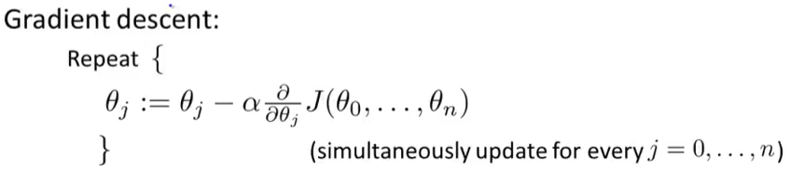
Gradient Descent for MULTIPLE Variables

Slide 39
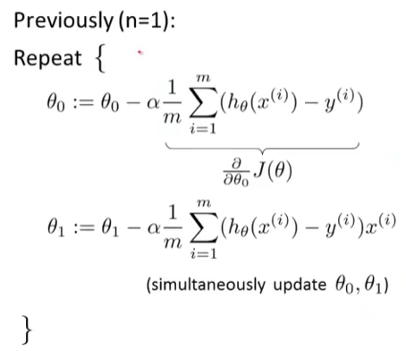
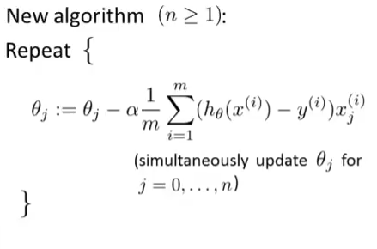
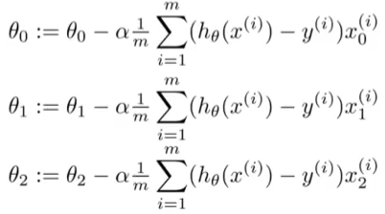
Gradient Descent for MULTIPLE Variables

Slide 40
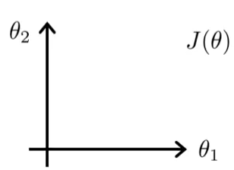
Gradient Descent: Feature Scaling
Make sure features are on a similar scale
Example:
X₁ = size (0 – 2000 ft²)
X₂ = number of bedrooms (1 - 5)
Contour plot

Slide 41
Gradient Descent: Feature Scaling
Let’s scale the features
X₁ = size (feet²)/2000
X₂ = number of bedrooms/5
Contour plot

Slide 42


Gradient Descent: Feature Scaling
Feature scaling
[0 ≤ X_{i} ≤ 1]
[-1 ≤ X_{i} ≤ 1]

Slide 43
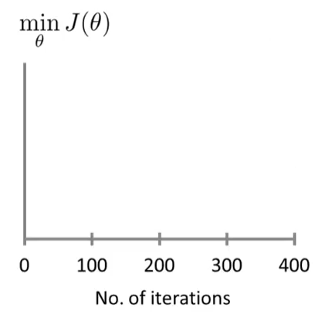
Gradient Descent: Learning Rate
Goal:
How to make sure gradient descent is working correctly and
choosing appropriate learning rate α.

Slide 44
Gradient Descent: Learning Rate
Summary
If α is too small, slow convergence
If α is too big, J(θ) may not decrease on every iteration; may not converge
To choose α, try different values 0.001, 0.003, 0.01, 0.03, 0.1,0.3, 1 etc

Slide 45
Creating More Features
Housing prices prediction
Define a new feature …..
h_{θ}(x) = θ₀ + θ₁ x length + θ₂ x width

Slide 46
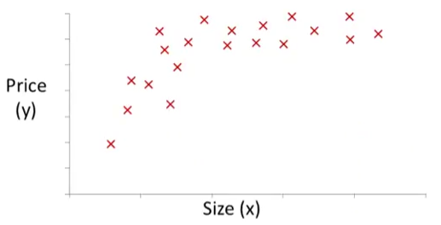





Polynomial Regression
h_{θ}(x) = θ₀ + θ₁x + θ₂x²
h_{θ}(x) = θ₀ + θ₁x + θ₂x²+ θ₃x³

Slide 47
Computing Parameters Analytically Normal Equations

Slide 48
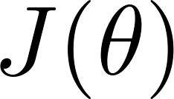

Gradient Descent
Normal equation: Method to solve for
analytically.

Slide 49
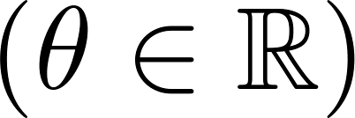
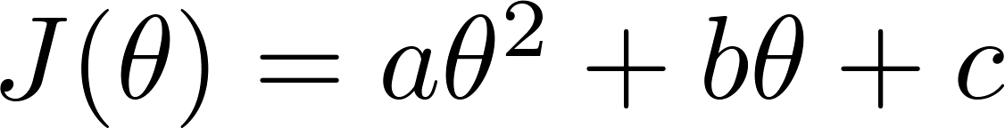

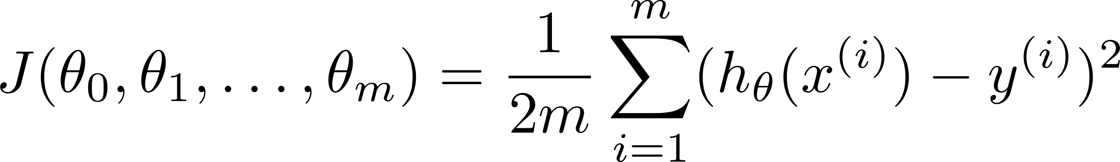
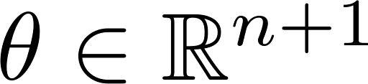
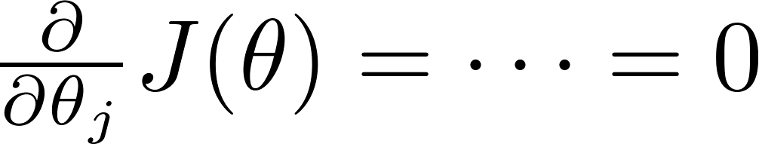


Intuition: If 1D
Take derivative, set equal to zero and solve to get optimal value of parameter with minimum value of cost function
(for every )
Solve for

Slide 50









Examples:
 | Size (feet²) | Number of bedrooms | Number of floors | Age of home (years) | Price ($1000)
1 | 2104 | 5 | 1 | 45 | 460
1 | 1416 | 3 | 2 | 40 | 232
1 | 1534 | 3 | 2 | 30 | 315
1 | 852 | 2 | 1 | 36 | 178
Size (feet²) | Number of bedrooms | Number of floors | Age of home (years) | Price ($1000)
2104 | 5 | 1 | 45 | 460
1416 | 3 | 2 | 40 | 232
1534 | 3 | 2 | 30 | 315
852 | 2 | 1 | 36 | 178
Notes:
Pop-up Quiz

Slide 51


is inverse of matrix

Slide 52



training examples, features.
Gradient Descent
Normal Equation
Need to choose .
Needs many iterations.
No need to choose .
Don’t need to iterate.
Works well even when is large.
Need to compute
Slow if is very large.

Slide 53
Normal equation
What if is non-invertible? (singular/ degenerate)
Causes inverse operation to fail!

Slide 54



What if is non-invertible?
Redundant features (linearly dependent).
E.g. size in feet²
size in m²
Too many features (e.g. ).
Delete some features, or use regularization.

